Slide 1

CAPSTONE PROJECT • SEMESTER VII
Property Value & Development
Impact Estimator
Woxsen University
School of Technology
Department of Computer Science and Engineering
Academic Year 2026–27
TEAM MEMBERS
Vignesh Rasuri
23WU0101189
Thota Abhishek
23WU0101178
GUIDE / MENTOR
Tangudu Santosh
23WU0101171
Prof. Dileep kumar

Slide 2


Problem Statement
Why an explainable regional impact platform is needed
The Problem
Project Objectives
Provide government market values for regions
Real estate websites only show current prices
Users cannot see how infrastructure projects will influence future value
Collect and process infrastructure development news
Estimate regional impact using rule-based scoring
Government development news is scattered across many sources
Display supporting evidence for every projection
No explainable regional impact estimation platform exists today
Present results on an interactive map
2

Slide 3




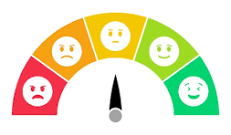


Proposed Solution
An explainable, evidence-backed regional impact platform
Interactive Map
Region Dashboard
Development News Feed
Explore regions visually with mandal and district level detail
Government market value and projection summary per region
Aggregated infrastructure news relevant to each region
Explainable Projection
Confidence Indicator
Evidence Panel
Projected value range grounded in rule-based impact scoring
Every projection is labeled with a confidence level
Direct links to the news articles behind each projection
SIMPLE WORKFLOW
News Collected
AI Extraction
Impact Scoring
Map & Dashboard
3

Slide 4
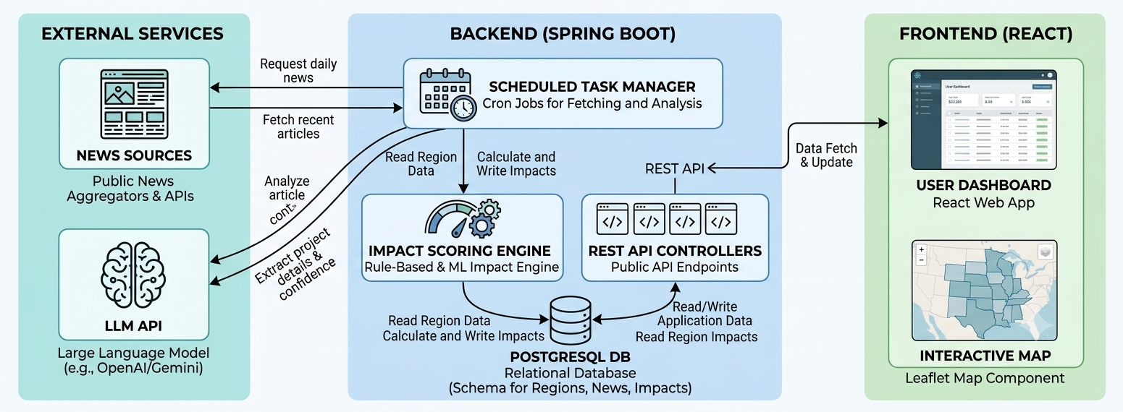
System Architecture
End-to-end data flow from news sources to the interactive dashboard
4
Notes:
NewsAPI.org free plan: 100 requests/day, max 100 articles/request, resets 00:00 UTC, development only (localhost).
NewsData.io free plan: 200 credits/day, 1 request = 1 credit, max 10 articles/request, articles delayed by 12 hours, resets 00:00 UTC.

Slide 5


Project Plan
Three-Phase execution timeline
1
Phase 1
2
Phase 2
3
phase 3
UI
Impact Engine
Database
News Integration
Testing
Architecture
LLM Extraction
Deployment
Backend APIs
EXPECTED DELIVERABLES
Interactive Map
Working News Pipeline
Evidence-backed Regional Projection
7

Slide 6


Expected Outcome & Future Scope
Expected Outcome
Future Scope
Users can view government market values
Cover all states in India
Users understand development impact on regions
Watchlist feature for tracked regions
Historical trend analysis
Every projection links to supporting news
Additional government datasets
Interactive world map for exploration
Mobile application
THANK YOU
Questions?

